Slide 1
Commerce Bank Online Banking Application
Kenneth Harris
Jorge Lopez-Flores
Scott Peery
Nicholas Wiegand

Slide 2
General System Architecture
Framework: ASP.NET Core MVC
Back-End Database: Microsoft SQL Server 2017
Controller logic: ASP.NET Entity Framework
Front-end framework: React API

Slide 3
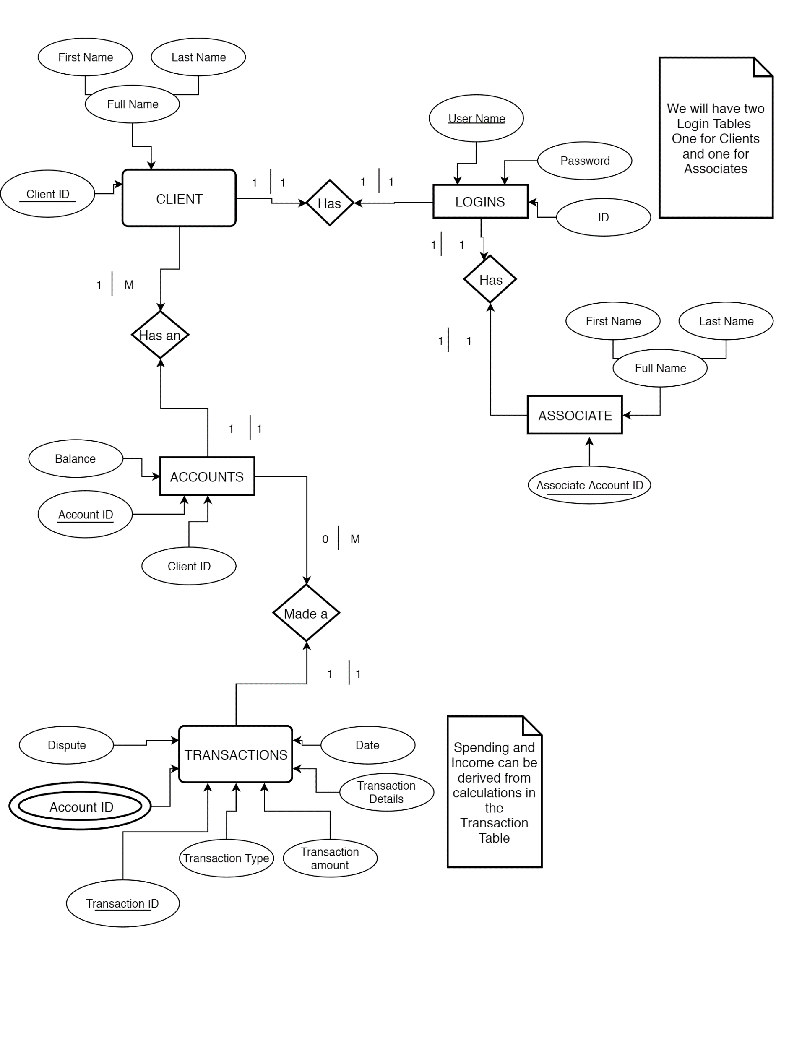

Slide 4
Feedback
Please ask any questions you might have or if you need us to clarify anything that was confusing
Any feedback or comments are also certainly welcome
Are there any concerns that Commerce has with our proposed architecture/solution?

